Slide 1

Root Cause Analysis and Action Plan for E-Commerce Sales Decline
This presentation outlines the root cause analysis for the recent sales decline in our e-commerce platform and presents a comprehensive action plan for recovery and future resilience. We'll explore the data pipeline issues, marketing inefficiencies, and customer reengagement strategies to address this challenge and ensure sustainable growth.

Slide 2
Uncovering the Root Cause: Five Whys Analysis
1
Why Sales Declined?
Answer: Commodities of customer traffic decreased on the platform.
2
Why Customer Traffic Dropped?
Answer: Marketing campaigns were poorly effective over the quarter.
3
Why Marketing Was Ineffective?
Answer: Ad spending and targeting strategies were not optimized for the audience.
4
Why Optimization Was Not Done?
Answer: A delay was seen in customer behavior analysis, thereby updating the strategy.
5
Why was there a delay in analyzing customer behavior?
Answer: There were delays in analytics receiving new customer data based on the pipeline data technical glitch.

Slide 3





The Core Issue: Data Pipeline Delay
1
Sales Decline
Traffic Reduction
2
Due to ineffective campaigns
Marketing Inefficiencies
3
Unoptimized strategies
Delayed Customer Insights
4
Data pipeline issue
Data Pipeline Glitch
5
Technical failure

Slide 4

Action Plan 💡
1. Fixing the Data Pipeline
1
Immediate Fix
2
Automation
Identify and rectify the specific technical problem in the pipeline.
This could involve resolving server capacity issues, debugging faulty scripts, or fixing database connections.
The urgency of this fix depends on the nature and severity of the issue.
Set up monitoring tools that automatically identify disruptions in pipeline operation and notify relevant teams immediately.
This proactive approach will ensure early detection and rapid resolution of issues.
3
Resilience
Re-engineer the data pipeline to make it more fault-tolerant and scalable.
This includes incorporating redundancy, implementing failover mechanisms, and designing for future growth.
This will minimize the impact of any potential failures and ensure seamless data flow.

Slide 5
2. Enhancing Marketing Strategy
Leverage Real-Time Insights
Refine Customer Segmentation
Focus on Winning Channels
Utilize updated customer behavior insights to optimize advertising placements and spending.
This includes identifying high-performing channels, targeting specific segments, and refining ad creative based on current trends.
Reevaluate customer segmentation based on real-time behavioral shifts.
This ensures accurate targeting and personalized messaging, increasing the effectiveness of marketing campaigns.
Maximize traffic and engagement by focusing on high-performing marketing channels.
This involves allocating resources to channels that deliver the best results and minimizing investment in underperforming channels.

Slide 6




3. Customer Retargeting Campaign
Personalized Emails
Exclusive Discounts
Product Reminders
Send targeted emails to previously lost or abandoned customers with personalized offers and reminders about products they viewed or added to their carts.
Offer exclusive discounts or limited-time promotions to incentivize dormant customers to return and make a purchase. This creates a sense of urgency and value.
Follow up with dormant users who previously viewed specific products. Send emails or push notifications reminding them about the products and encouraging them to complete their purchase.

Slide 7




4. Improving Processes
Cross-Functional Team
Form a cross-functional team that oversees the data pipeline, analytics, and marketing to ensure better coordination and communication between departments.
Regular Performance Reviews
Schedule regular reviews of campaign performance, incorporating new customer data and insights to continuously refine marketing strategies and optimize results.
Contingency Plans
Develop contingency plans to maintain marketing performance even when data is delayed. This includes pre-planned strategies to address potential disruptions and minimize negative impact.

Slide 8
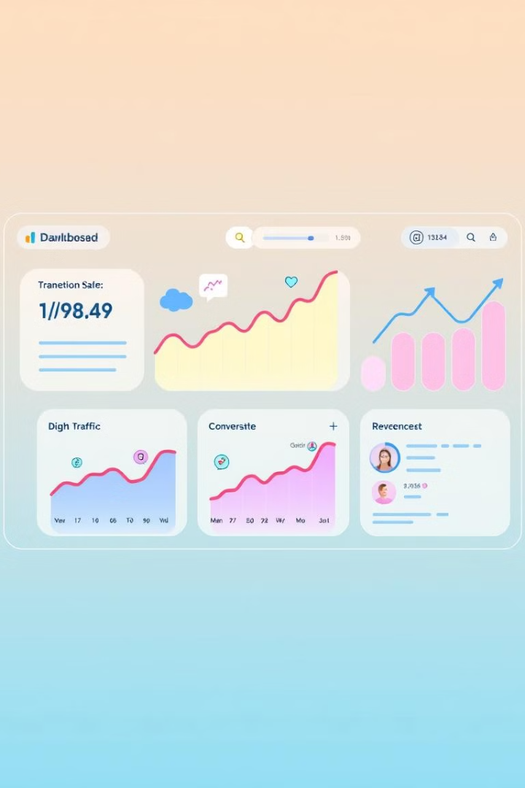
Conclusion and Next Steps
1
Key Takeaways
The five whys technique demonstrated that a seemingly simple technical failure in the data pipeline can have significant consequences for business performance.
2
Next Steps
Implement the action plan to address the root cause of the sales decline, including fixing the data pipeline, enhancing marketing strategy, and improving processes.
3
Future Resilience
By adopting preventive measures and proactive monitoring, we can build a robust e-commerce platform that is resilient to similar issues, ensuring sustainable growth and customer satisfaction.

